Slide 1
Search in Complex Environments
By Abeeha Sattar

Slide 2
Agenda
Local Search: Hill Climbing
Escaping Local Maxima: Local Beam Search
Simulated Annealing
Genetic Algorithm

Slide 3
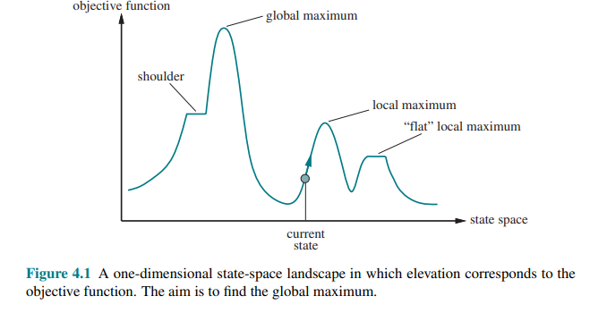
Local Search
Use single current state and move to the neighboring state.
Idea: Start with an initial guess at a solution and incrementally improve it until it is one.

Slide 4
Hill Climbing/Gradient Descent Algorithms
Categories: Local Search, Greedy Approach, No Backtracking
In this algorithm, we don't need to maintain and handle the search tree or graph as it only keeps a single current state
Hill climbing algorithm continuously moves in the direction of increasing elevation/value to find the peak or best solution to the problem.
It terminates when it reaches a peak value where no neighbor has a higher value.
It is also called greedy local search as it only looks to its good immediate neighbor state and not beyond that.
Gradient Descent is the opposite of hill climbing. Here we try to minimize the value of the objective function to try and reach the global minima (or a valley)

Slide 5
Hill Climbing Algorithm
Step 1: Evaluate the initial state, if it is goal state then return success and Stop.
Step 2: Loop Until a solution is found or there is no new operation left to apply.
Step 3: Select and apply an operation to the current state.
Step 4: Check new state:
If it is goal state, then return success and quit.
Else if it is better than the current state then assign new state as a current state.
Else if not better than the current state, then return to step 2.
Step 5: Exit.

Slide 6
Examples
1 |  | 3
4 | 2 | 6
7 | 5 | 8
1 | 2 | 3
 | 4 | 6
7 | 5 | 8
 | 2 | 3
1 | 4 | 6
7 | 5 | 8
1 | 2 | 3
4 | 5 | 6
 | 7 | 8
1 | 2 | 3
4 | 5 | 6
7 | 8
U h=4
D h=4
R h=6
U h=5
D h=7
L h=5
R h=5
L h=6
R h=9
U h=6
1 | 2 | 3
4 | 5 | 6
7 |  | 8
Initial State Goal State
1 | 2 | 3
7 | 4 | 6
 | 5 | 8
1 | 2 | 3
4 | 5 | 6
7 | 8
1 | 2 | 3
 | 4 | 6
7 | 5 | 8
1 | 2 | 3
4 |  | 6
7 | 5 | 8
1 | 2 | 3
4 |  | 6
7 | 5 | 8
1 | 2 | 3
4 | 6
7 | 5 | 8

Slide 7
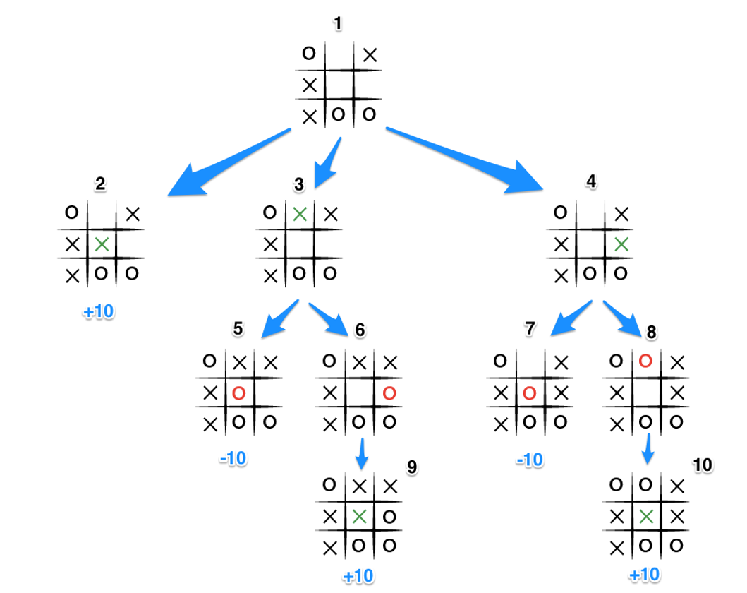
Another Example

Slide 8
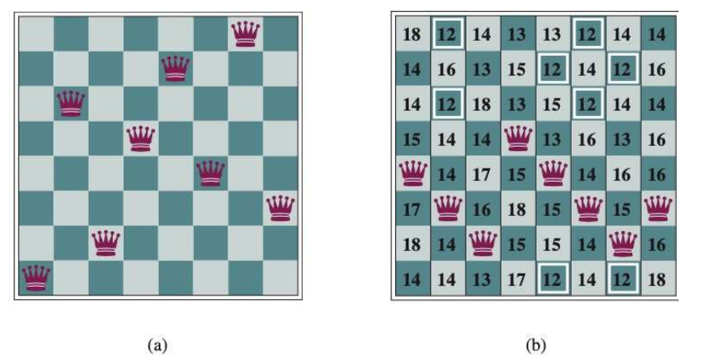
8-Queens Problem

Slide 9
Problems with Hill Climbing
Local Maxima
A local maximum is a peak that is higher than each of its neighboring states but lower than the global maximum. Hill-climbing algorithms that reach the vicinity of a local maximum will be drawn upward toward the peak but will then be stuck with nowhere else to go.

Slide 10
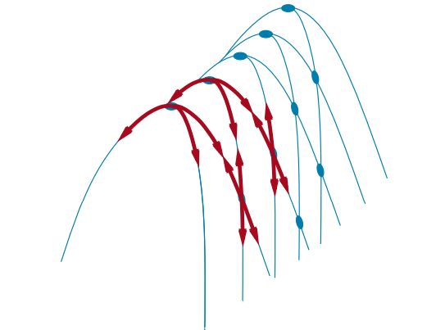
Problems with Hill Climbing
Ridges
Ridges result in a sequence of local maxima that is very difficult for greedy algorithms to navigate.
Easier with increasing dimensions.

Slide 11
Problems with Hill Climbing
Plateaus
A plateau is a flat area of the state-space landscape. It can be a flat local maximum, from which no uphill exit exists, or a shoulder, from which progress is possible.

Slide 12
How fast is it?
Starting from a randomly generated 8-queens state, steepest-ascent hill climbing gets stuck 86% of the time, solving only 14% of problem instances.
On the other hand, it works quickly, taking just 4 steps on average when it succeeds and 3 when it gets stuck—not bad for a state space with 8⁸ ≈ 17 million states.

Slide 13
Variants of Hill Climbing Algorithms
Stochastic hill climbing: chooses at random from among the uphill moves; the probability of selection can vary with the steepness of the uphill move.
First-choice hill climbing: implements stochastic hill climbing by generating successors randomly until one is generated that is better than the current state. This is a good strategy when a state has many (e.g., thousands) of successors.
Random-restart hill climbing: It conducts a series of hill-climbing searches from randomly generated initial states, until a goal is found. It is complete with probability 1, because it will eventually generate a goal state as the initial state.

Slide 14
Simulated Annealing
A hill-climbing algorithm that never makes “downhill” moves toward states with lower value (or higher cost) is always vulnerable to getting stuck in a local maximum.
A purely random walk that moves to a successor state without concern for the value will eventually stumble upon the global maximum, but will be extremely inefficient.

Slide 15
Simulated Annealing
Annealing is the process used to temper or harden metals and glass by heating them to a high temperature and then gradually cooling them, thus allowing the material to reach a low-energy crystalline state.
In AI…
Early on, the algorithm jumps around freely, exploring widely.
As temperature decreases, the “jumps” become smaller and more selective, honing in on promising solutions.

Slide 16
Simulated Annealing
Early steps involve large, random jumps that cover the landscape.
Middle steps: selective exploration of promising valleys.
Final steps: fine-tuning around the lowest found point.
Algorithm:
Begin with an initial solution by selecting a random one from the solution space.
Evaluate its quality – calculate the cost or objective function value.
Generate a neighboring solution – make a small random change to the current solution.
Decide whether to accept the new solution:
If it’s better (lower cost), accept it.
If it’s worse, accept it with a probability that decreases as the temperature drops.
Reduce the temperature according to the cooling schedule.
Repeat steps 3–5 until the system “freezes” (temperature is low or no significant improvements are observed).

Slide 17
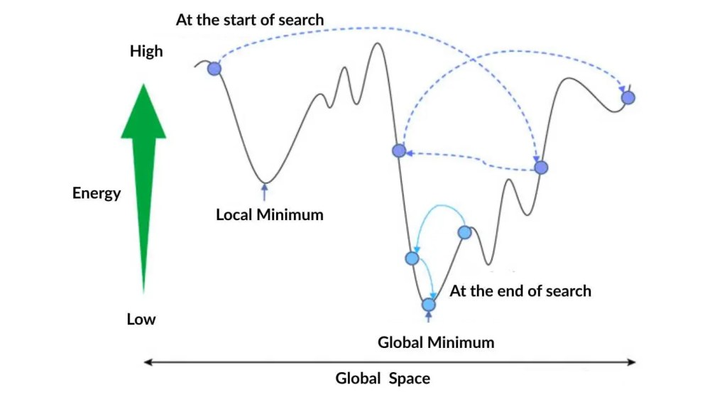
Simulated Annealing
https://spotintelligence.com/2025/10/22/simulated-annealing-made-simple-how-to-tutorial-in-python/

Slide 18
Local Beam Search
Start with k randomly generated states (k= 2 or 3, etc)
At each iteration, all the successors of all k states are generated
If any one is a goal state, stop; else select the k best successors from the complete list and successors from the complete list and repeat
A variant called stochastic beam search, analogous to stochastic hill climbing, helps alleviate this problem. Instead of choosing the top k successors, stochastic beam search chooses successors with probability proportional to the successor’s value, thus increasing diversity.

Slide 19
Evolutionary Algorithms
Evolutionary algorithms can be seen as variants of stochastic beam search that are explicitly motivated by the metaphor of natural selection in biology.
The fittest (highest value) states produce offspring (successor states) that populate the next generation.
This process is called recombination.

Slide 20
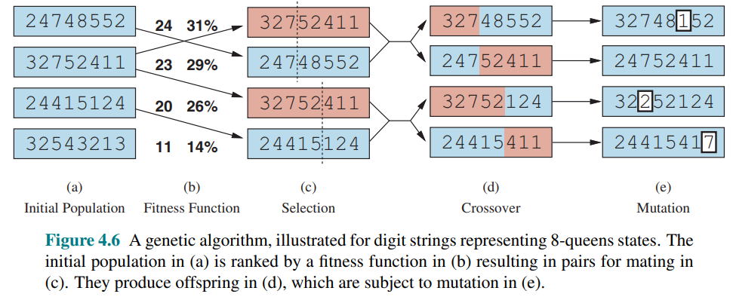
Example

Slide 21
Genetic Algorithm - Terms
Population = Set of Solutions
Individual = Solution to a Problem
Fitness = Quality of the Solution
Chromosome = Encoding of a Solution
Gene = Part of the encoding of a Solution
Reproduction = Crossover
Mutation = Mutation in the Gene, based off some mutation rate
Elitism = Few top-scoring parents from the previous generation are added to new generation
Culling = All individuals below a given threshold are discarded

Slide 22
How does it work?
Represent/Encode individuals as strings
Generate an initial population
Apply fitness function
Select parents according to fitness, to generate new offspring
Crossover parent ‘genes’ to produce new generation
Mutate new generation with some probability to bring diversity

Slide 23
Encoding
The process of representing a solution in the form of a string that conveys necessary information.
Binary Encoding: Store a chromosome as a string of 1s and 0s
Permutation Encoding: Each chromosome is a string of numbers, where each number may represent for e.g., a city to be visited, in the traveling salesman problem.
Value Encoding: If binary encoding is not enough, we may use this encoding. It makes use of complex values such as real numbers.

Slide 24
Crossover
Combining two chromosomes (strings) to produce an offspring which carries both their genes/characteristics
Methods may vary, but commonly we use:
Single Point Crossover
Two-Point Crossover
Uniform Crossover

Slide 25
Example:
Chromosome 1: 011010 | Chromosome 2: 110100
Assume crossover point is 2 Assume crossover point is 2 and 4
Single Point Crossover | Two-Point Crossover
010100 | 010110
111010 | 111000

Slide 26
Example: Uniform Crossover
Uniform Crossover will yield only one offspring.
Each gene (0 or 1) is chosen with equal probability
110000
Or…
010100
…Or more, but only one will be made, not many.
Chromosome 1: 011010 | Chromosome 2: 110100

Slide 27
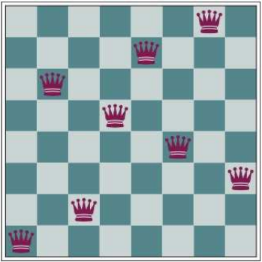
8 Queens Example
Population:
Row of queen in each column.
[1,6,2,5,7,4,8,3]
Fitness Function
Number of non-attacking pairs of queens (unique pairs)

Slide 28
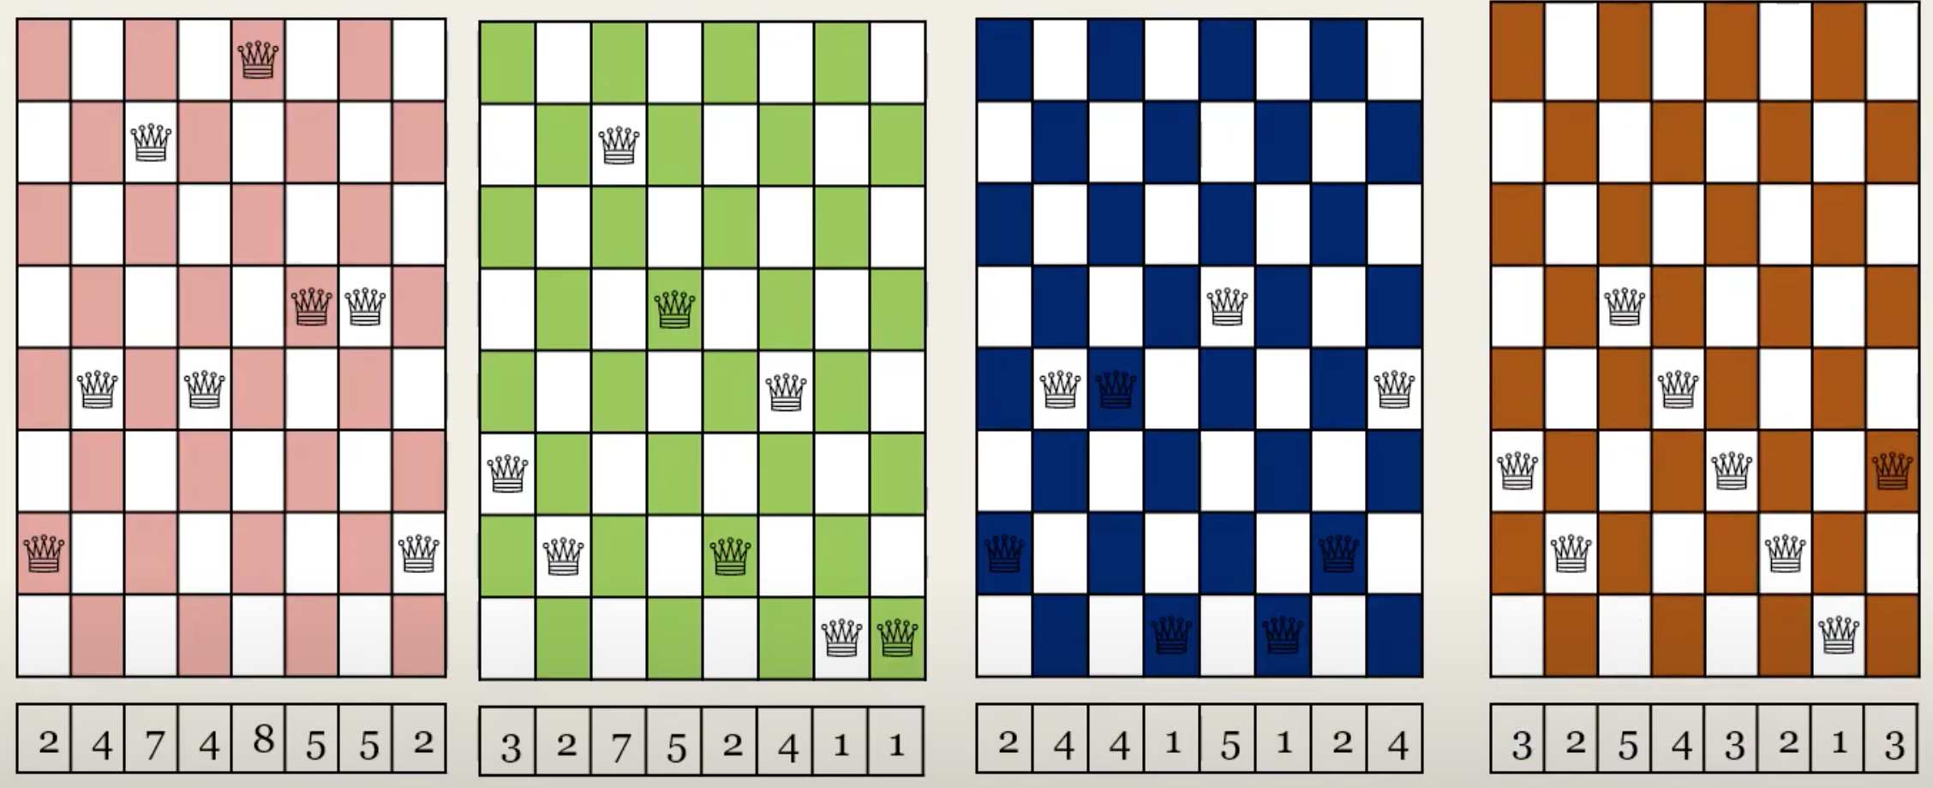
Initial Population + Fitness (count of nonattacking pair of queens)
Fitness: 24
Fitness: 23
Fitness: 20
Fitness: 11

Slide 29
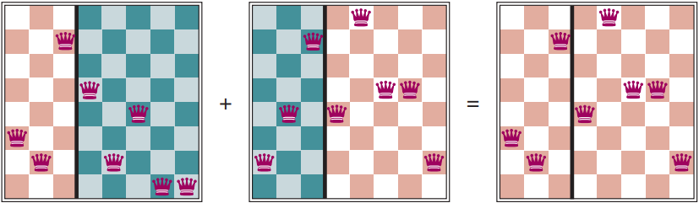
Crossover
Σ_{i}(fitness(C_{i}))= 24+23+20+11 = 78
P₁= Fitness(C₁)/Σ_{i}(fitness_{i}) = 24/78 = 0.31
P₂= Fitness(C₂)/Σ_{i}(fitness_{i}) = 23/78 = 0.29
P₃= Fitness(C₃)/Σ_{i}(fitness_{i}) = 20/78 = 0.26
P₄= Fitness(C₄)/Σ_{i}(fitness_{i}) = 11/78 = 0.14

Slide 30
Properties
Works well with continuous and discrete problems
Less susceptible to getting stuck in local optima
Computationally expensive, but easier to perform in parallel
There’s no math involved, aside from the fitness function
The fitness function might be difficult to figure out

Slide 31
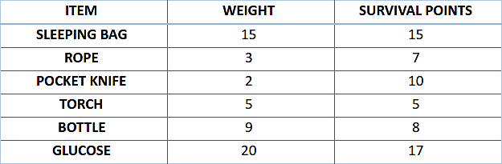
Knapsack Problem
Let’s say, you are going to spend a month in the wilderness. Only thing you are carrying is the backpack which can hold a maximum weight of 30 kg. Now you have different survival items, each having its own “Survival Points” (which are given for each item in the table). So, your objective is maximizing the survival points.
Here is the table giving details about each item.

Slide 32
Tasks:
Choose an initial population of four. Then choose best three subsequently (Encoding hint: 1 if item is chosen 0 otherwise)
Decide crossover point.
Chance of mutation = 50 items in 100 generations.
Solution ahead: Courtesy of Miss Anaum.

Slide 33
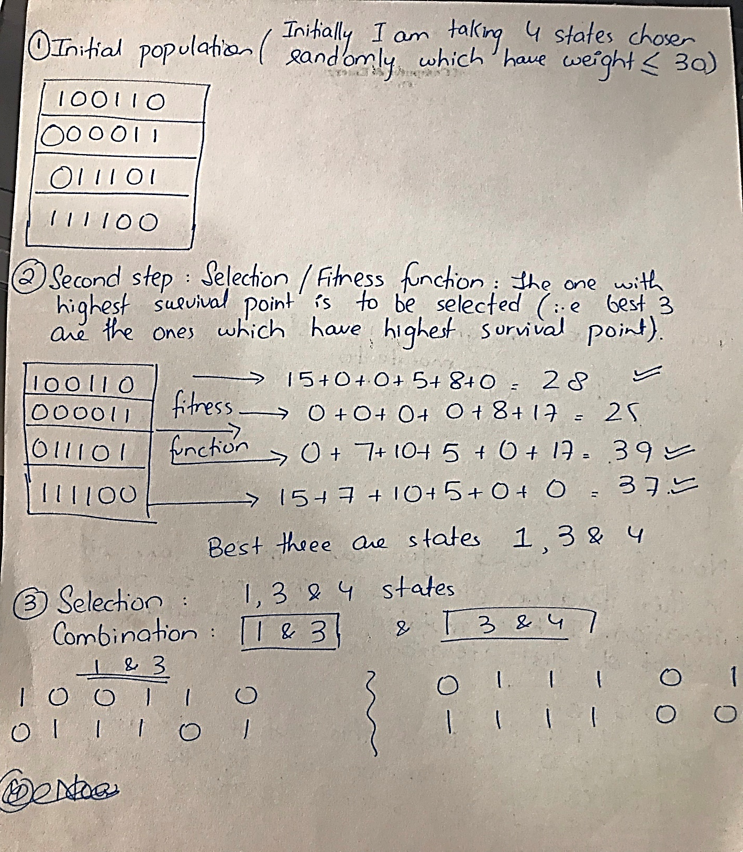

Slide 34
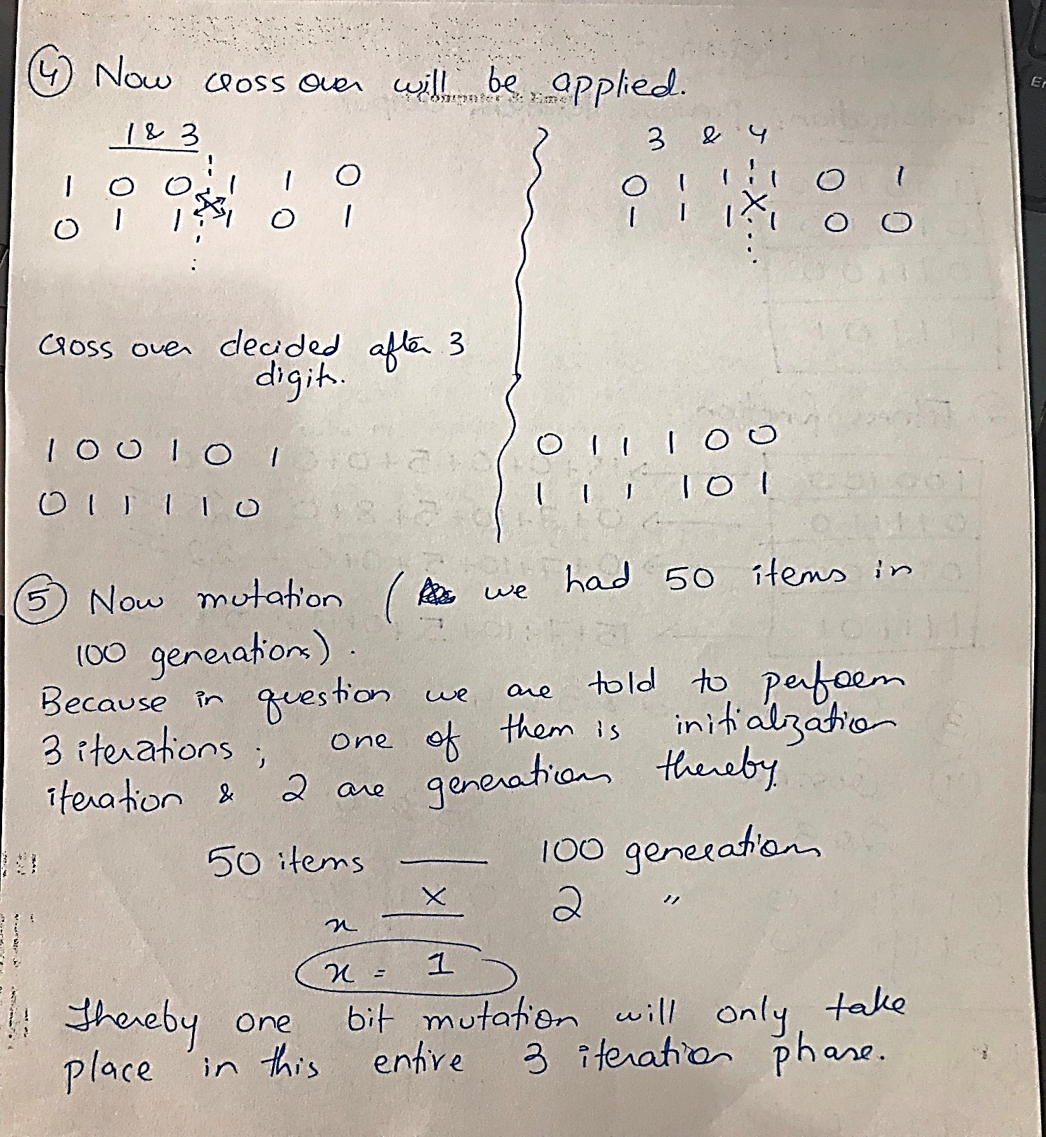

Slide 35
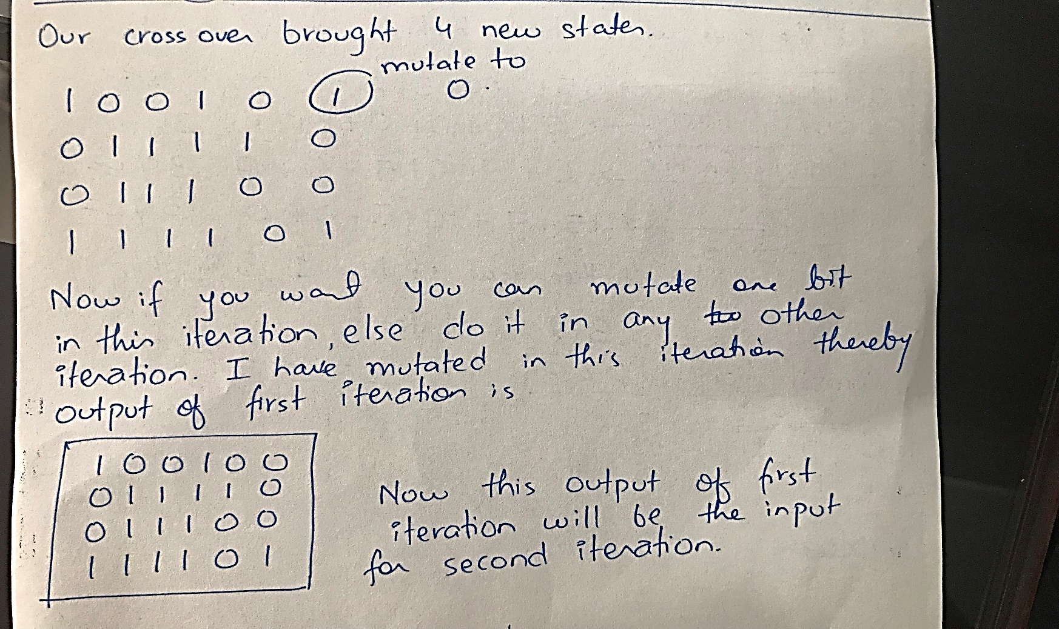

Slide 36
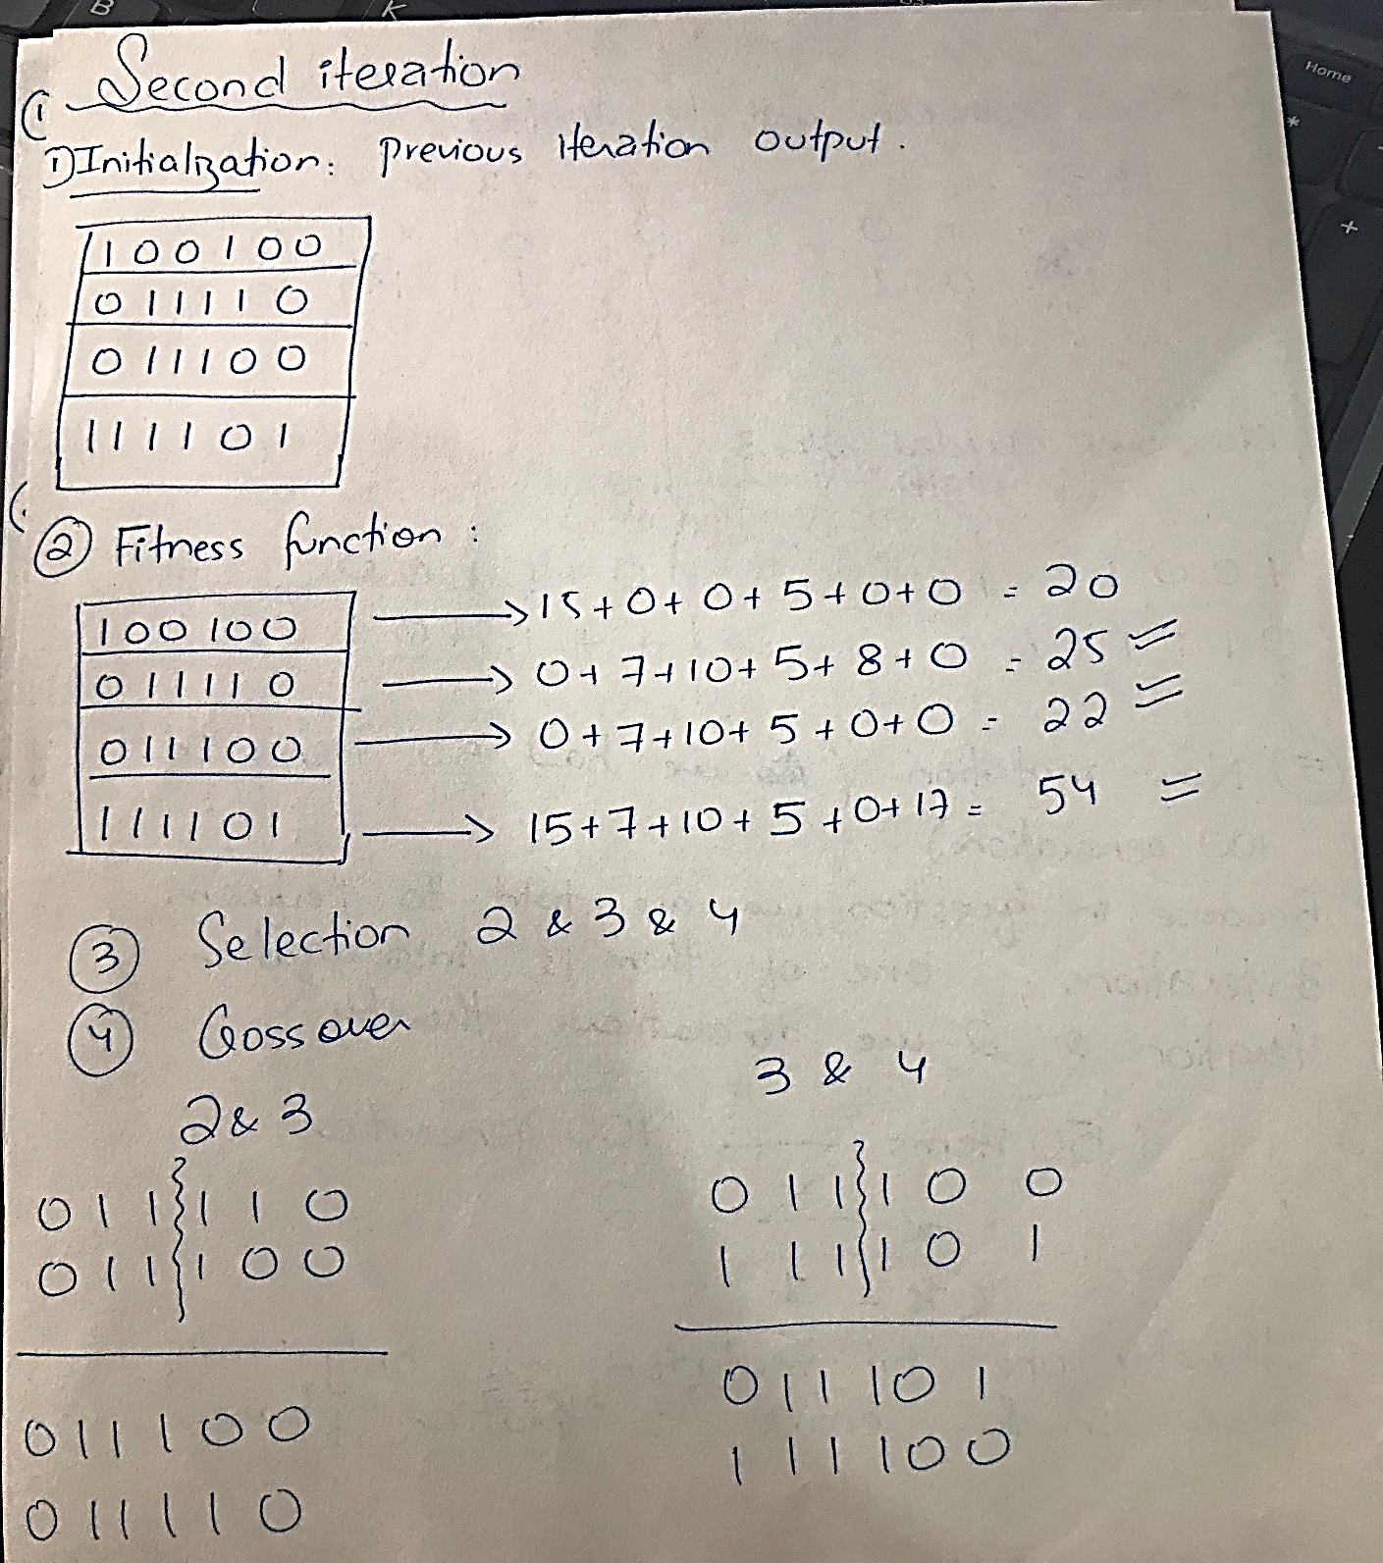

Slide 37
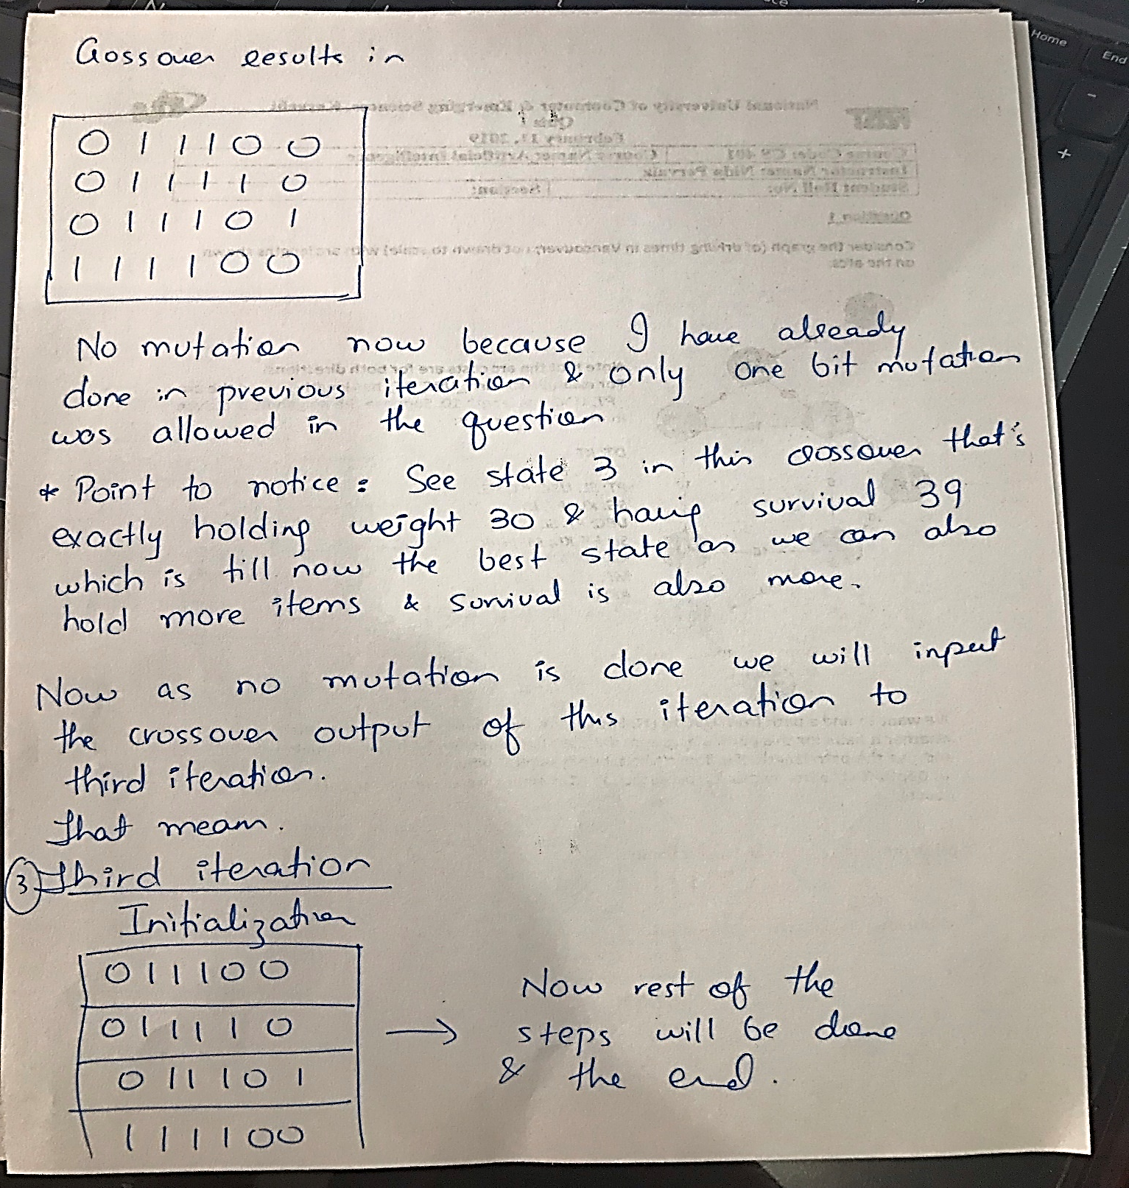
You can do the third iteration on your own now…

Slide 38
Fin.
>:3

